Slide 1
Jabil Piece Parts Approval Process (JPPAP) Introduction
Norhissam Hasbullah
March 2016

Slide 2
What is PPAP?
Production Part Approval Process
Standard used to formally reduce risks prior to product or service release, in a team oriented manner using well established tools and techniques
Initially developed by AIAG (Auto Industry Action Group) in 1993 with input from the Big 3 - Ford, Chrysler, and GM
AIAG’s 4th edition effective June 1, 2006 is the most recent version
PPAP has now spread to many different industries beyond automotive

Slide 3
Purpose of PPAP
Provide evidence that all customer engineering design record and specification requirements are properly understood by the organization
To demonstrate that the manufacturing process has the potential to produce product that consistently meets all requirements during an actual production run at the quoted production rate
PPAP manages change and ensures product conformance!

Slide 4
When is PPAP Required?
New part
Engineering change(s)
Tooling: transfer, replacement, refurbishment, or additional
Correction of discrepancy
Tooling inactive > one year
Change to optional construction or material
Sub-supplier or material source change
Change in part processing
Parts produced at a new or additional location
PPAP is required with any significant change to product or process!

Slide 5
Benefits of PPAP Submissions
Helps to maintain design integrity
Identifies issues early for resolution
Reduces warranty charges and prevents cost of poor quality
Assists with managing supplier changes
Prevents use of unapproved and nonconforming parts
Identifies suppliers that need more development
Improves the overall quality of the product & customer satisfaction

Slide 6
Production Run
PPAP data must be submitted from a production run using:
Production equipment and tooling
Production employees
Production rate
Production process
All data reflects the actual production process to be used at start-up!

Slide 7
Run @ Rate
The purpose of a Run @ Rate is to verify the supplier’s manufacturing process is capable of producing components that meet quality requirements, at quoted tooling capacity, for a specified period of time
Verification of the Run @ Rate will be at the Supplier Quality Engineer’s (SQE) discretion. The supplier will be notified of the need to perform a Run @ Rate as early in the process as possible.
The number of components to be produced during the Run @ Rate should be sufficient to demonstrate process capability and will be predetermined by the SQE and the supplier.
Factors such as product complexity, shelf life, storage, cost and single shift vs. multiple shift operations will be taken into consideration

Slide 8
Jabil PPAP Requirements
Feasibility Report
Packaging proposal for customer approval
Authorized Engineering Change Documents (if any)
Customer Engineering Approval (if any)
Process Flow Diagram
Process Failure Modes and Effects Analysis (PFMEA)
Control Plan
Measurement Systems Analysis (MSA)
Dimensional Results/FAIR
Material / Performance Test Results
Process Capability Studies
Appearance Approval Report (AAR)
Sample Production Parts
Work Instruction
Drawing
Gauge/Tooling List
Training Skill Matrix
Part Submission Warrant (PSW)

Slide 9
PPAP Submission Levels
Level 1 | Production Warrant and Appearance Approval Report (if applicable) submitted to Jabil
Level 2 | Production Warrant, product samples, and dimensional results submitted to Jabil
Level 3 | Production Warrant, product samples, and complete supporting data submitted to Jabil
Level 4 | Production Warrant and other requirements as defined by Jabil
Level 5 | Production Warrant, product samples and complete supporting data (a review will be conducted at the supplier's manufacturing location)

Slide 10
PPAP Submission Level Table
Submission Level
Requirement | Level 1 | Level 2 | Level 3 | Level 4 | Level 5
Feasibility Reports | S | S | S | S | S
Packaging proposal for customer approval | S | S | S | S | S
Authorized Engineering Change Documents | R | S | S | * | R
Customer Engineering Approval | R | S | S | * | R
Process Flow Diagram | R | R | S | * | R
Process FMEA | R | R | S | * | R
Control Plan | R | R | S | * | R
Measurement Systems Analysis (MSA) | R | R | S | * | R
Dimensional Results/FAIR | R | S | S | * | R
Material / Performance Test Results | R | S | S | * | R
Process Capability Studies | R | R | S | * | R
Appearance Approval Report (AAR) | S | S | S | * | R
Sample Production Parts | R | S | S | * | R
Checking Aids | R | R | S | * | R
Drawing | R | R | S | * | R
Gauge/Tooling List | R | R | S | * | R
Training Skill Matrix | R | R | S | * | R
Part Submission Warrant (PSW) | S | S | S | S | R
S = The supplier shall submit designated product approval activity and retain a copy of records or documentation items at appropriate locations including manufacturing.
R = Supplier shall retain at appropriate locations, including manufacturing, and make readily available to Jabil representative upon request.
* = If applicable or required.
S = Supplier shall submit designated product approval activity and retain a copy of records or documentation items at appropriate locations including manufacturing
* = If applicable or required.
R = Supplier shall retain at appropriate locations, including manufacturing, and make readily available to Jabil representative upon request.

Slide 11

PPAP Status
Approved
The part meets all Jabil requirements
Supplier is authorized to ship production quantities of the part
Conditional Approval
Permits shipment of part on a limited time or piece quantity basis
Rejected
The part does not meet Jabil requirements, based on the production lot from which it was taken and/or accompanying documentation
Production quantities may not be
shipped before Jabil Approval

Slide 12
Electronic Submission Requirements
Jabil requires that all PPAPs be submitted electronically
Submission must be received on or prior to the PPAP due date
Review and Approval Process:
Jabil will attempt to review and provide feedback within 2 business days
Jabil requires all submissions to be electronic

Slide 13
Part Submission Warrant

Slide 14


Part Submission Warrant
Part Submission
Jabil Production Part Approval Process (JPPAP)
Submission Date: |  |  | Part Description:
Part Number: |  |  | Revision / ECN: |  |  | Project Name:
Drawing No /Rev |  |  | Drawing Pages |  |  |  | Part Weight (grms): | Runner Weight (grms): | PPAP Level
Details of Submission
Supplier Information and Declaration
Name: |  |  |  |  | Submitted By:
Address:
Location: |  |  |  |  | Reviewed By:
Submission Reason |  |  |  | Submission Documentation |  |  | Need for this Submission (Y/N) ? | Re-Submitted(Change)/ Initial Submission
Initial Submission |  |  |  | Sample(s) / AAR
Engineering Change(s) |  |  |  | Capability Study
Tooling:Transfer, Replacement, Refurbishment, or additional |  |  |  | Dimensional Evaluation (FAI)
Correction of Discrepancy |  |  |  | Deviation / Action details
Change to Optional Material |  |  |  | Gage R&R
Change in Part Processing |  |  |  | Process FMEA
Sub-Supplier, Manufacturing or Material Source Change |  |  |  | Process Flow
Tooling inactive > 12 Months |  |  |  | Process Management Plan / Org Chart
Dimensional FAI Submission Results |  |  |  | Process Work Instructions
Parts / Samples meet all drawing specifications requirements (Tick appropriate box) |  |  |  | Training Skills Metric
 |  |  |  | Master Gauge / tooling list
Yes |  |  |  | Control Plan
No |  |  |  |  | RoHS Accomplishment / Information per P/N
Deviation- Action sheet to be completed |  |  |  |  | Other (Define Below)
Parts are cosmetically acceptable
Yes |  | No
Is each Customer Tool properly tagged and numbered ? |  |  |  | Yes | No | Tool Order No.
Print Name: |  |  | Title: |  |  | Phone: |  | Fax:
Supplier Authorized Signature: |  |  |  | Email: |  |  |  | Date:
Supplier Comments
Submission Sign Off ( Jabil / Customer)
Approval Status
Approved |  |  | Jabil Quality / Engineering - Site (Signature) |  |  |  |  | Date
Rejected |  |  |  | Printed Name
Conditional Approval |  |  | Customer Quality / Engineering (Signature). "Not Mandatory"
Approved / Agreed Run Rate |  |  |  | Printed Name |  |  |  | Date
Ref Deviation / Action sheet for Reject / Conditional Approval / Details fo Conditional Approval :
Comments:
 |  |  |  |  |  |  |  | Form00-MT80-1000-00801
What is It?
Document required for all newly tooled or revised products in which the supplier confirms that inspections and tests on production parts show conformance to Jabil requirements
Objective or Purpose
Used to :
document part approval
provide key information
declare that the parts meet specification
When to Use It
Prior to shipping production parts
Now, let’s take a closer look

Slide 15
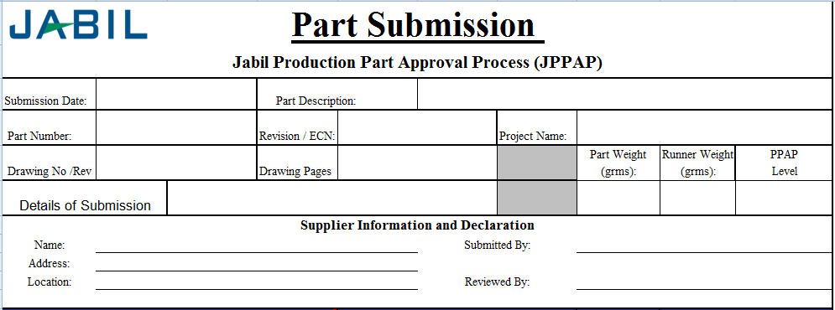
Part Submission Warrant
Submission Date
Enter the date when the
PSW was submitted
Part Description
Enter the Part Description
defined in drawing
Part Number / Revision
Enter the Jabil Part Number,
And Revision / ECN
Project Name
Enter the Project Name
Drawing No/Rev, Drawing Pages
Enter the Drawing No, Drawing
Pages information.
Part Weight / Runner Weight
Enter part weight information.
And runner weight for injection
molding parts
Supplier Name / Address / Location
Enter supplier’s name / address
/ location information.
PPAP Level
Enter the defined PPAP
submission level here.
(level 1 ~ level 5)
Submitted By / Reviewed by
Enter the responsible people
who submitted / reviewed the
whole PPAP documents.

Slide 16
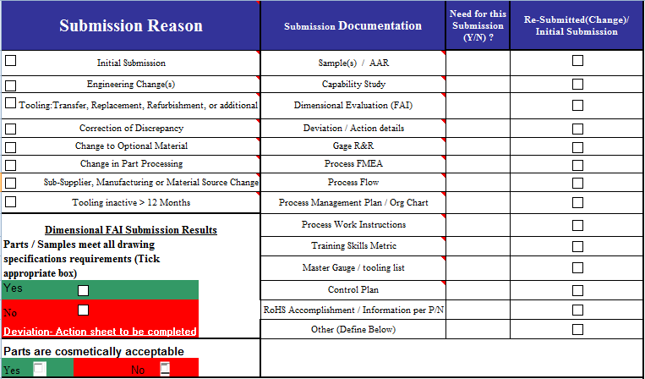
Part Submission Warrant
Cosmetic
Tick to choose whether the parts’
cosmetic is approved by Jabil
responsible engineers or not.
Submission Reason
Tick to choose the reason for
PPAP submission
Dimensional FAI Results
Tick to choose the result of FAI
Results. If any requirements in
drawing is not met, Deviation-
Action sheet must be completed.
Submission Documentation
Choose the documentation need
to submit per the PPAP level
and SQE requirements.

Slide 17
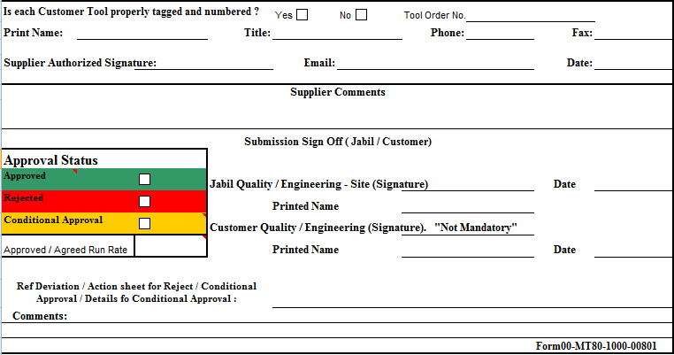
Part Submission Warrant
Customer Tool
If the tool was customer property,
tick “Yes”, and fill in the Tool No.
Otherwise, tick “No”.
Supplier Contact Information
Fill supplier’s contact window
information and sign here.
Approval Status
Tick to choose the Approval Status
by Jabil Jabil Quality / Engineering.
Or Customer representative,
if applicable.
Submission Sign Off
Sign by Jabil Jabil Quality / Engineering.
Or Customer representative, if applicable.
Ref Deviation / Action sheet
If PPAP is Conditional Approval, details of
Conditional Approval, such as time limitation,
or qty limitation should be described. And
action plan need to be provided.

Slide 18
AUTHORIZED ENGINEERING CHANGE DOCUMENTS

Slide 19
Authorized Engineering Change Documents
The supplier shall provide authorized change documents for those changes not yet recorded in the design record, but incorporated in the product, part or tooling, such as:
ECNs (must be approved, not pending)
Specifications
Feasibility studies
Supplier change requests
Sub-assembly drawings
Life or reliability testing requirements

Slide 20
PROCESS FLOW DIAGRAM

Slide 21
Process Flow Diagram
What is It?
A visual diagram of the entire process from receiving through shipping, including outside processes and services
Objective or Purpose
To help people “see” the real process. Process maps can be used to understand the following characteristics of a process:
Set-by-step process linkage
Offline activities (measurement, inspection, handling)
Rework, scrap
When to Use It
To understand how a process is done
Prior to completing the PFMEA

Slide 22
Process Flow Diagram
The process flow diagram utilizes these symbols to clearly identify each step in the process

Slide 23
Process Flow Diagram - Example

Slide 24
PROCESS FMEA

Slide 25
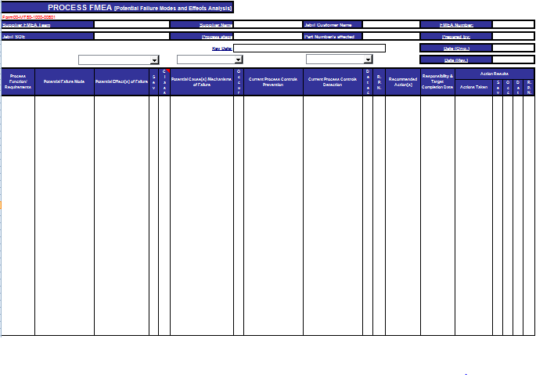
Process FMEA (PFMEA)

Slide 26
PFMEA - Step 1
Failure Modes
For each Process Input,
determine the ways in
which the input can go
wrong.
Using the completed
Process Flow Diagram,
enter the process step.
TIPS
There should be at least one failure mode for each input.

Slide 27
PFMEA - Step 2
Potential Failure Effects
For each Failure Mode,
determine what effect
the specific failure
could have on the
process output.
TIPS
There should be at least one failure effect for each failure mode.
Effects should be specific, clear, and leave no doubt to the uninformed reviewer.

Slide 28
PFMEA - Step 3
Potential Causes
For each Failure Mode,
determine the possible cause of the failure.
TIPS
There should be at least one potential cause for each failure mode.

Slide 29
PFMEA - Step 4
Current Controls
For each potential
cause, list the current
method used for
preventing or detecting
failure.
TIPS
This step in the FMEA begins to identify initial shortcomings or gaps in the current control plan.
If a procedure exists, enter the document number.
If no current control exists, list as “none.”

Slide 30
PFMEA - Step 5
Assign Severity, Occurrence, and Detection ratings
Assign Severity
(How serious is the effect if it fails?)
Assign Detection
(How easily can the cause or failure
mode be detected?)
Assign Occurrence (How likely is the cause to occur?)
Severity, Occurrence and Detection rating details on next slide

Slide 31
PFMEA - Definition of Terms
Severity (of Effect) - severity of the effect on the Customer and other stakeholders (Higher Value = Higher Severity)
Occurrence (of Cause) - frequency with which a given Cause occurs and creates Failure Mode. (Higher Value = Higher Probability of Occurrence)
Detection (Capability of Current Controls) - ability of current control scheme to detect the cause before creating the failure mode and/or the failure mode before suffering the effect (Higher Value = Lower Ability to Detect)
Caution: Notice the scale difference for Detection!

Slide 32
Example of Rating Definitions
Rating
Severity | Occurrence | Detection*
Hazardous without warning | Very high and almost inevitable | Cannot detect or detection with very low probability
Loss of primary function | High repeated failures | Remote or low chance of detection
Loss of secondary function | Moderate failures | Low detection probability
Minor defect | Occasional failures | Moderate detection probability
No effect | Failure unlikely | Almost certain detection
High 10
Low 1
*If No Controls Exist, Detection = 10
Create a rating system that makes sense for the
defects you are trying to prevent.

Slide 33
PFMEA - Step 6
Calculate the Risk Priority Number RPN = Severity x Occurrence x Detection
TIPS
The RPN is used to prioritize the most critical risks identified in the first half of the FMEA.
High RPNs are flags to take effort to reduce the calculated risk.
Regardless of RPN, high Severity scores (9 or 10) should be given special attention.

Slide 34
PFMEA – Remediation Guidelines
Severity – can only be improved by a design change to the product or process
Occurrence – can only be reduced by a change which removes or controls a cause. Examples are redundancy, substituting a more reliable component or function or mistake-proofing.
Detection – can be reduced by improving detection. Examples are mistake-proofing, simplification and statistically sound monitoring.
In general, reducing the Occurrence
is preferable to improving the Detection

Slide 35
FMEA – Step 7
Determine Actions Recommended to reduce High RPNs
For the high RPN numbers,
determine the
recommended actions.

Slide 36
FMEA – Steps 8 and 9
Resp (responsibility)
Assign a specific person
who will be responsible for recommended actions.
Actions Taken
As actions are identified
and completed, document
in the “Actions Taken”
column.
SEV, OCC, DET, RPN
As actions are complete
reassess Severity,
Occurrence, and Detection
and recalculate RPN.
Now recalculate your RPNs
based on mitigation plans.
TIPS:
Continue updating the actions taken and resulting RPNs until all risks are at an acceptable level.

Slide 37
Summary Steps To Complete a FMEA
For each Process Input, determine the ways in which the Process Step can go wrong (these are Failure Modes).
For each Failure Mode associated with the inputs, determine Effects on the outputs.
Identify potential Causes of each Failure Mode.
List the Current Controls for each Cause.
Assign Severity, Occurrence and Detection ratings after creating a ratings key appropriate for your project.
Calculate RPN.
Determine Recommended Actions to reduce High RPNs.
Take appropriate Actions and Document.
Recalculate RPNs.
Revisit steps 7 and 8 until all the significant RPNs have been addressed.

Slide 38
CONTROL PLAN

Slide 39
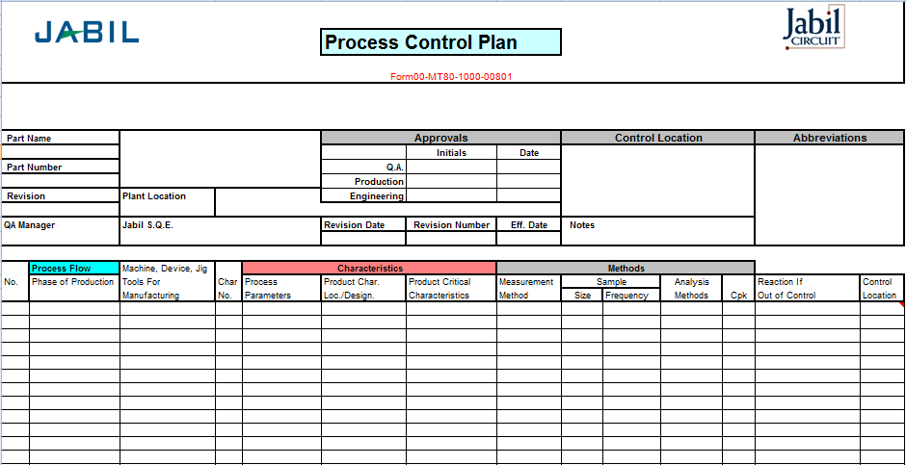
Control Plan
What is It?
A document that describes how to control the critical inputs to continue to meet customer expectations of the output.
Objective or Purpose
Primary reference source for minimizing process and product variation.
Description of how teams should react to out-of-control situations.
Since processes are expected to be continuously
updated and improved, the control plan
is a living document!
When to Use It
Implementation of new process
Following a process change

Slide 40
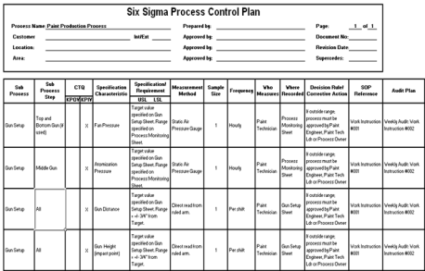
Control Plan
Tool Interaction
Process Steps
New/Revised Process Steps
Process FMEA
Process Flowchart
Risk Prioritized
Process Steps
Process Steps
New/Revised
Process Steps
Improved
Controls
Control Plan

Slide 41
Control Plan
 |  |  |  |  | Process Control Plan
 |  |  |  |  | Form00-MT80-1000-00801
Part Name |  |  |  |  | Approvals |  |  | Control Location |  |  |  | Abbreviations
 |  |  |  |  |  | Initials | Date
Part Number |  |  |  |  | Q.A.
 |  |  |  |  | Production
Revision |  | Plant Location |  |  | Engineering
QA Manager |  | Jabil S.Q.E. |  |  | Revision Date | Revision Number | Eff. Date | Notes
 | Process Flow | Machine, Device, Jig |  | Characteristics |  |  | Methods
No. | Phase of Production | Tools For | Char | Process | Product Char. | Product Critical | Measurement | Sample |  | Analysis |  | Reaction If | Control
 |  | Manufacturing | No. | Parameters | Loc./Design. | Characteristics | Method | Size | Frequency | Methods | Cpk | Out of Control | Location

Slide 42
Control Plan
 |  |  |  |  | Process Control Plan
 |  |  |  |  | Form00-MT80-1000-00801
Part Name |  |  |  |  | Approvals |  |  | Control Location |  |  |  | Abbreviations
 |  |  |  |  |  | Initials | Date
Part Number |  |  |  |  | Q.A.
 |  |  |  |  | Production
Revision |  | Plant Location |  |  | Engineering
QA Manager |  | Jabil S.Q.E. |  |  | Revision Date | Revision Number | Eff. Date | Notes
 | Process Flow | Machine, Device, Jig |  | Characteristics |  |  | Methods
No. | Phase of Production | Tools For | Char | Process | Product Char. | Product Critical | Measurement | Sample |  | Analysis |  | Reaction If | Control
 |  | Manufacturing | No. | Parameters | Loc./Design. | Characteristics | Method | Size | Frequency | Methods | Cpk | Out of Control | Location
Part Description
Identifies Part Name, Part
Number and Revision.
Initials and Date
Supplier’s initial and QA
Manager’ signature and
Date.
Jabil SQE
The place for Jabil SQE
Approval
Document Info.
Control Plan’s issue date,
Rev., and Effective. date.

Slide 43
Control Plan
 |  |  |  |  | Process Control Plan
 |  |  |  |  | Form00-MT80-1000-00801
Part Name |  |  |  |  | Approvals |  |  | Control Location |  |  |  | Abbreviations
 |  |  |  |  |  | Initials | Date
Part Number |  |  |  |  | Q.A.
 |  |  |  |  | Production
Revision |  | Plant Location |  |  | Engineering
QA Manager |  | Jabil S.Q.E. |  |  | Revision Date | Revision Number | Eff. Date | Notes
 | Process Flow | Machine, Device, Jig |  | Characteristics |  |  | Methods
No. | Phase of Production | Tools For | Char | Process | Product Char. | Product Critical | Measurement | Sample |  | Analysis |  | Reaction If | Control
 |  | Manufacturing | No. | Parameters | Loc./Design. | Characteristics | Method | Size | Frequency | Methods | Cpk | Out of Control | Location
Process
Use this area to define process
number and description.
Characteristics
Define the characteristics of
the product and process
Machine/Tools
List the machine, device, jig,
or tools that will be used in
the manufacturing process

Slide 44
Control Plan
 |  |  |  |  | Process Control Plan
 |  |  |  |  | Form00-MT80-1000-00801
Part Name |  |  |  |  | Approvals |  |  | Control Location |  |  |  | Abbreviations
 |  |  |  |  |  | Initials | Date
Part Number |  |  |  |  | Q.A.
 |  |  |  |  | Production
Revision |  | Plant Location |  |  | Engineering
QA Manager |  | Jabil S.Q.E. |  |  | Revision Date | Revision Number | Eff. Date | Notes
 | Process Flow | Machine, Device, Jig |  | Characteristics |  |  | Methods
No. | Phase of Production | Tools For | Char | Process | Product Char. | Product Critical | Measurement | Sample |  | Analysis |  | Reaction If | Control
 |  | Manufacturing | No. | Parameters | Loc./Design. | Characteristics | Method | Size | Frequency | Methods | Cpk | Out of Control | Location
Sample
Define sample size and
sampling frequency.
CPK
Define whether Cpk analysis
needed for this characteristics.
Analysis Method
Define the measurement system
analysis method.
Measurement Method
List the method used for the
characteristics measurement.

Slide 45
Control Plan
 |  |  |  |  | Process Control Plan
 |  |  |  |  | Form00-MT80-1000-00801
Part Name |  |  |  |  | Approvals |  |  | Control Location |  |  |  | Abbreviations
 |  |  |  |  |  | Initials | Date
Part Number |  |  |  |  | Q.A.
 |  |  |  |  | Production
Revision |  | Plant Location |  |  | Engineering
QA Manager |  | Jabil S.Q.E. |  |  | Revision Date | Revision Number | Eff. Date | Notes
 | Process Flow | Machine, Device, Jig |  | Characteristics |  |  | Methods
No. | Phase of Production | Tools For | Char | Process | Product Char. | Product Critical | Measurement | Sample |  | Analysis |  | Reaction If | Control
 |  | Manufacturing | No. | Parameters | Loc./Design. | Characteristics | Method | Size | Frequency | Methods | Cpk | Out of Control | Location
Control Location
Define the location to execute
the control, such as on-line,
QC Lab, etc..
Reaction
List the action plan if the
characteristics out of requirements.

Slide 46
MEASUREMENT SYSTEM ANALYSIS (MSA)

Slide 47
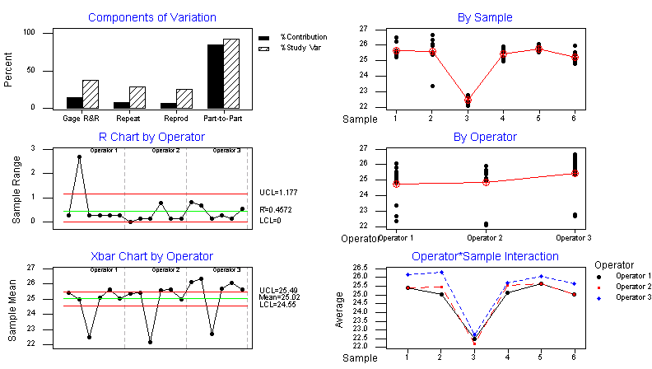
Measurement System Analysis (MSA)
What is It?
An MSA is a statistical tool used to determine if a measurement system is capable of precise measurement.
Objective or Purpose
To determine how much error is in the measurement due to the measurement process itself.
Quantifies the variability added by the measurement system.
Applicable to attribute data and variable data.
When to Use It
On the critical inputs and outputs prior to collecting data for analysis.
For any new or modified process in order to ensure the quality of the data.
IMPORTANT!
Measurement System Analysis is an analysis of the measurement process, not an analysis of the
people!!
Who Should be Involved
Everyone that measures and makes decisions about these measurements should be involved in the MSA.

Slide 48
Attribute and Variable MSA
Attribute Data Examples:
Count, Pass/fail, yes/no, red/green/yellow, timekeeping buckets
Variable Data Examples:
Physical measurement (length, width, area, …)
Physical conditions (temperature, pressure…)
Physical properties (strength, load, strain…)
Continuous or non-ending

Slide 49
Measurement System Analysis (MSA)
Measurement
System
Variation
The observed variation in process output measurements is not simply the variation in the process itself; it is the variation in the process plus the variation in measurement that results from an inadequate measurement system.
Observed
Variation
Process
Variation
Conducting an MSA reduces the likelihood of passing a bad part or rejecting a good part

Slide 50
Measurement System Analysis (MSA)
Observed Variation
Measurement
System
Variation
Observed
Variation
The output of the process
measured by:
Cycle time
Dimensional data
Number of defects and others
Process
Variation

Slide 51
Observed Variation
Measurement System Analysis (MSA)
Resolution
Precision
(Variability)
Repeatability
Reproducibility
Measurement
System
Variation
Linearity
Observed
Variation
Accuracy
(Central Location)
Bias
Stability
Process
Variation
Calibration addresses accuracy

Slide 52
Measurement System Analysis (MSA)
Observed Variation
Resolution
Precision
(Variability)
Repeatability
Reproducibility
Measurement
System
Variation
Linearity
Observed
Variation
Accuracy
(Central Location)
Bias
Stability
Process
Variation
Calibration Addresses Accuracy
Let’s take a closer look at Precision

Slide 53


Measurement System Analysis (MSA)
Resolution
Error in Resolution The inability to detect small changes.
Possible Cause Wrong measurement device selected - divisions on scale not fine enough to detect changes.

Slide 54


Measurement System Analysis (MSA)
Repeatability
Error in Repeatability The inability to get the same answer from repeated measurements made of the same item under absolutely identical conditions.
Possible Cause Lack of standard operating procedures (SOP), lack of training, measuring system variablilty.
Equipment Variation

Slide 55
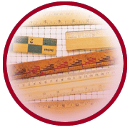

Measurement System Analysis (MSA)
Reproducibility
Error in Reproducibility The inability to get the same answer from repeated measurements made under various conditions from different inspectors.
Possible Cause Lack of SOP, lack of training.
Appraiser Variation

Slide 56
Variable MSA – Gage R&R Study
Gage R&R is the combined estimate of measurement system Repeatability and Reproducibility
Typically, a 3-person study is performed
Each person randomly measures 10 marked parts per trial
Each person can perform up to 3 trials
There are 3 key indicators
EV or Equipment Variation
AV or Appraiser Variation
Overall % GRR

Slide 57
Variable MSA – Gage R&R Study
OPERATOR 1 |  |  |  |  | OPERATOR 2 |  |  |  | OPERATOR 3
Sample | Trial 1 | Trial 2 | Trial 3 | Range | Trial 1 | Trial 2 | Trial 3 | Range | Trial 1 | Trial 2 | Trial 3 | Range
1 |  |  |  | 0.0000 |  |  |  | 0.0000 |  |  |  | 0.00
2 |  |  |  | 0.0000 |  |  |  | 0.0000 |  |  |  | 0.00
3 |  |  |  | 0.0000 |  |  |  | 0.0000 |  |  |  | 0.00
4 |  |  |  | 0.0000 |  |  |  | 0.0000 |  |  |  | 0.00
5 |  |  |  | 0.0000 |  |  |  | 0.0000 |  |  |  | 0.00
6 |  |  |  | 0.0000 |  |  |  | 0.0000 |  |  |  | 0.00
7 |  |  |  | 0.0000 |  |  |  | 0.0000 |  |  |  | 0.00
8 |  |  |  | 0.0000 |  |  |  | 0.0000 |  |  |  | 0.00
9 |  |  |  | 0.0000 |  |  |  | 0.0000 |  |  |  | 0.00
10 |  |  |  | 0.0000 |  |  |  | 0.0000 |  |  |  | 0.00
TTLS |  |  | 0 | 0.000 |  |  | 0 | 0.0000 | 0 | 0 | 0 | 0.00
 |  |  |  | 0.0000 |  |  |  | 0.0000 |  |  |  | 0.00
 | Sum | 0.0000 |  |  | Sum | 0.0000 |  |  | Sum | 0.0000
 | XA | #DIV/0! |  |  | XB | #DIV/0! |  |  | XC
TEST FOR CONTROL |  |  |  |  |  |  |  |  |  | X min | #DIV/0!
Upper Control Limit, UCLr = D4R = |  |  |  | 2.57000 | x | 0.00000 | = | 0.0000 |  | X max | #DIV/0!
If any individual range exceeds this limit, the measurement or reading should be reviewed, repeated,
corrected, or discarded as appropriate, and new averages and ranges should be computed
Factors
# Trials | 2 | 3 | # Oprs | 2 | 3
K1 | 4.56 | 3.05 | K2 | 3.65 | 2.70
D4 | 3.27 | 2.57 | n=# parts, t=# trials
MEASUREMENT SYSTEM / GAUGE / CAPABILITY |  |  |  |  |  |  |  |  |  |  | Repeatability
Equipment Variation ("Repeatability") = K1R = |  |  |  |  |  |  | 3.05000 | x | 0.00000 | = | 0.00000
 |  |  |  |  |  |  |  |  | Reproducibility |  | % Tolerance
Operator Variation ("Reproducibility") = (K2*Xdiff)² - (EV)²/nxt |  |  |  |  |  |  |  |  |  |  | #DIV/0!
 |  |  |  |  |  |  |  |  | Total |  | % Tolerance
Total "repeatability" and "reproducibility" Variation (R&R) = |  |  |  |  |  |  |  |  |  |  | #DIV/0!
Automatically calculates EV, AV, and % GRR!

Slide 58
Variable MSA – Gage R&R Steps
Step 1
Step 2
Step 3
Step 4
Step 5
Step 6
Step 7
Step 8
Step 9
Step 10
Select 10 items that represent the full range of long-term process variation.
Identify the appraisers.
If appropriate, calibrate the gage or verify that the last calibration date is valid.
Open the Gage R&R worksheet in the PPAP form 00-MT80-1000-00801 to record data.
Have each appraiser assess each part 3 times (trials – first in order, second in reverse order, third random).
Input data into the Gage R&R worksheet.
Enter the number of operators, trials, samples and specification limits
Analyze data in the Gage R&R worksheet.
Assess MSA trust level.
Take actions for improvement if necessary.

Slide 59
Variable MSA – Gage R&R Steps
Select 10 items that represent
the full range of long-term process
variation.
Step 1
Identify the appraisers.
Should use individuals that actually do the process being tested.
Can also include other appraisers (supervisors, etc.).
Should have a minimum of 2 appraisers. Recommend to arrange 3 appraisers.
Step 2

Slide 60
Variable MSA – Gage R&R Steps
If appropriate, calibrate the gage
or verify that the last calibration
date is valid.
Step 3
Open the Gage R&R worksheet in the
PPAP form 00-MT80-1000-00801 to
record the data
Step 4

Slide 61
Variable MSA – Gage R&R Steps
Have each appraiser assess each item at minimum 2 times (Recommend 3 times).
Each appraiser has to work independently.
Items should be evaluated in random order.
After each appraiser completes the first evaluation of all items – repeat the process at least 1 more times (Recommend 2 more times).
Do not let the appraisers see any of the data during the test !!
Step 5

Slide 62
Variable MSA – Gage R&R Steps
Input data into the Gage R&R worksheet
Step 6
Enter the number of operators, trials, samples and specification limits
Step 7

Slide 63
Variable MSA – Gage R&R Steps
Analyze data in the Gage R&R worksheet
Step 8
Assess MSA Trust Level.
Red: > 30% (fail)
Yellow: 10-30% (marginal)
Green: < 10% (pass)
Step 9
% Tolerance*
30%
10%

Slide 64
Variable MSA – Gage R&R Steps
If the Measurement System needs improvement:
Brainstorm with the team for improvement solutions.
Determine best “practical solution” (may require some experimentation).
Pilot the best solution (PDSA)
Implement best solution – train employees.
Re-run the study to verify the improvement.
Step 10

Slide 65
Variable MSA – Gage R&R Example
One GR&R analysis example base on Jabil GR&R format in PPAP template
00-MT80-1000-00801
Part Info.
Fill in the P/N, Part Name and
critical characteristic for analysis
Measurement Unit
The measurement device
for analysis
Part Number : |  | XXXXXX |  |  | Description : |  | Pad
Characteristic : |  | Width |  |  |  |  |  |  | Zero=
Specification : |  | 10.00+/-0.15 |  |  | TTL Tolerance: |  | 0.3 |  | Measurement Unit: |  | Peojector
Supplier Name |  | XXXX |  |  | Analysis Supervised by : |  |  |  |  | XXX
Inspector Name: |  | OPERATOR 1 |  |  | Date Inspected: |  | XXXX |  | # Oprs | 3
Inspector Name: |  | OPERATOR 2 |  |  | Date Inspected: |  | XXXX |  | # Trials | 3
Inspector Name: |  | OPERATOR 3 |  |  | Date Inspected: |  | XXXX
Specification & Tolerance
Fill in the characteristic’s Spec and
Tolerance.
#Oprs & #Trials
How many appraisers and how
many time trials for analysis

Slide 66
Variable MSA – Gage R&R Example
OPERATOR 1 |  |  |  |  | OPERATOR 2 |  |  |  | OPERATOR 3
Sample | Trial 1 | Trial 2 | Trial 3 | Range | Trial 1 | Trial 2 | Trial 3 | Range | Trial 1 | Trial 2 | Trial 3 | Range
1 | 10.02 | 10.02 | 10.01 | 0.0100 | 10.01 | 10.01 | 10.01 | 0.0000 | 10.02 | 10.1 | 10.01 | 0.09
2 | 10.04 | 10.03 | 10.03 | 0.0100 | 10.03 | 10.04 | 10.03 | 0.0100 | 10.03 | 10.03 | 10.03 | 0.00
3 | 9.98 | 9.98 | 9.98 | 0.0000 | 9.99 | 9.98 | 9.98 | 0.0100 | 9.98 | 9.98 | 9.98 | 0.00
4 | 9.99 | 9.98 | 9.98 | 0.0100 | 9.98 | 9.99 | 9.98 | 0.0100 | 9.98 | 9.98 | 9.98 | 0.00
5 | 10 | 10.01 | 10 | 0.0100 | 10 | 10.01 | 10.01 | 0.0100 | 10 | 10 | 10.01 | 0.01
6 | 10.01 | 10.01 | 10.01 | 0.0000 | 10.01 | 10.01 | 10.01 | 0.0000 | 10.01 | 10.01 | 10.01 | 0.00
7 | 10.06 | 10.06 | 10.06 | 0.0000 | 10.06 | 10.06 | 10.05 | 0.0100 | 10.06 | 10.06 | 10.06 | 0.00
8 | 10.02 | 10.02 | 10.01 | 0.0100 | 10.03 | 10.02 | 10.02 | 0.0100 | 10.02 | 10.02 | 10.02 | 0.00
9 | 10.03 | 10.02 | 10.02 | 0.0100 | 10.03 | 10.03 | 10.02 | 0.0100 | 10.02 | 10.02 | 10.03 | 0.01
10 | 10.01 | 10.02 | 10.02 | 0.0100 | 10.02 | 10.01 | 10.02 | 0.0100 | 10.02 | 10.02 | 10.02 | 0.00
TTLS | 100.16 | 100.2 | 100.1 | 0.070 | 100.2 | 100.2 | 100.1 | 0.0800 | 100.14 | 100.22 | 100.15 | 0.11
 |  |  |  | 0.0070 |  |  |  | 0.0080 |  |  |  | 0.01
 | Sum | ###### |  |  | Sum | ###### |  |  | Sum | 300.5100
 | XA | 10.0143 |  |  | XB | 10.0150 |  |  | XC | 10.0170
TEST FOR CONTROL |  |  |  |  |  |  |  |  |  | X min | 10.0143
Upper Control Limit, UCLr = D4R = |  |  |  | 2.57000 | x | 0.00867 | = | 0.0223 |  | X max | 10.0170
If any individual range exceeds this limit, the measurement or reading should be reviewed, repeated,
corrected, or discarded as appropriate, and new averages and ranges should be computed
Factors
# Trials | 2 | 3 | # Oprs | 2 | 3
K1 | 4.56 | 3.05 | K2 | 3.65 | 2.70
D4 | 3.27 | 2.57 | n=# parts, t=# trials
MEASUREMENT SYSTEM / GAUGE / CAPABILITY |  |  |  |  |  |  |  |  |  |  | Repeatability |  | % Tolerance
Equipment Variation ("Repeatability") = K1R = |  |  |  |  |  |  | 3.05000 | x | 0.00867 | = | 0.02643 |  | 8.8%
 |  |  |  |  |  |  |  |  | Reproducibility |  | % Tolerance
Operator Variation ("Reproducibility") = (K2*Xdiff)² - (EV)²/nxt |  |  |  |  |  |  |  |  |  |  | 0.00534 |  | 1.8%
 |  |  |  |  |  |  |  |  | Total |  | % Tolerance
Total "repeatability" and "reproducibility" Variation (R&R) = |  |  |  |  |  |  |  |  |  |  | 0.02697 |  | 9.0%
Select 10 samples
to be measured
Arrange 3 operators
to be appraisers.
Each operator measure
3 times
The result will be
Calculated automatically

Slide 67
Variable MSA – Gage R&R Example
 | Sum | ###### |  |  | Sum | ###### |  |  | Sum | 300.5100
 | XA | 10.0143 |  |  | XB | 10.0150 |  |  | XC | 10.0170
TEST FOR CONTROL |  |  |  |  |  |  |  |  |  | X min | 10.0143
Upper Control Limit, UCLr = D4R = |  |  |  | 2.57000 | x | 0.00867 | = | 0.0223 |  | X max | 10.0170
If any individual range exceeds this limit, the measurement or reading should be reviewed, repeated,
corrected, or discarded as appropriate, and new averages and ranges should be computed
Factors
# Trials | 2 | 3 | # Oprs | 2 | 3
K1 | 4.56 | 3.05 | K2 | 3.65 | 2.70
D4 | 3.27 | 2.57 | n=# parts, t=# trials
MEASUREMENT SYSTEM / GAUGE / CAPABILITY |  |  |  |  |  |  |  |  |  |  | Repeatability |  | % Tolerance
Equipment Variation ("Repeatability") = K1R = |  |  |  |  |  |  | 3.05000 | x | 0.00867 | = | 0.02643 |  | 8.8%
 |  |  |  |  |  |  |  |  | Reproducibility |  | % Tolerance
Operator Variation ("Reproducibility") = (K2*Xdiff)² - (EV)²/nxt |  |  |  |  |  |  |  |  |  |  | 0.00534 |  | 1.8%
 |  |  |  |  |  |  |  |  | Total |  | % Tolerance
Total "repeatability" and "reproducibility" Variation (R&R) = |  |  |  |  |  |  |  |  |  |  | 0.02697 |  | 9.0%
EV:
Equipment Variation,
Repeatability
AV:
Appraiser Variation,
Reproducibility
% Tolerance is < 10% MSA Acceptable!
% Tolerance*
30%
10%
R&R
Total Repeatability &
Reproducibility

Slide 68
DIMENSIONAL RESULTS

Slide 69
Dimensional Results--FAIR
What is It?
 |  | FIRST ARTICLE / FIRST PIECE / INSPECTION REPORT (FAIR)
 |  | Customer |  |  |  |  |  | Part Description:
Supplier Part No: |  |  | Jabil Part No : |  |  |  |  | Dwg. # |  |  |  |  |  | Dwg. Rev Level. |  |  |  |  |  | Dwg. Last Revision Date:
No. of Cavities: |  |  |  |  | Blocked Cav. No.: |  |  |  |  |  | Requested By: |  |  |  |  | Date:
Material Type: |  |  |  |  | Tool ID # |  |  |  |  |  | Inspected By: |  |  |  |  | Date:
REMARKS: |  |  |  |  |  |  |  |  |  |  | Program Mngr: |  |  |  |  | Date:
MEASURING APPARATUS (ABBREVIATION TABLE) CMM = COORDINATE MEASURING MACHINE, DG = DEPTH GAUGE, HG = HEIGHT GAUGE, IM = INTERNAL MICROMETER, COMP.Comparator Optico PG = PIN GAUGE, M = MICROMETER, AV = Avant , CAL = CALIPER
Total # of Dim. Checked : |  | 26 | % OUT OF TOL. |  | 19.23% |  |  |  |  |  |  |  |  | Dims above |  | 3 |  |  | Total # of Reject :
 |  |  |  |  |  |  |  |  |  |  |  | #REF! |  | Dims below |  | 2 |  |  |  | 5
DRAWING SPECIFICATIONS |  |  |  |  | Inspection Method | INSPECTION RESULTS |  |  |  |  |  |  |  |  |  |  |  |  |  |  |  |  | INSPECTION ANALYSIS |  |  |  | Customer Engineering Disposition
Drg. Desig-nator No. |  | Dimensions, Notes or Standards | + Tol. | - Tol. |  | Cavity # |  |  |  |  |  |  |  | Deviation from Nominal |  |  |  |  |  |  |  |  | % Tolerance |  | Reject
 | Description |  |  |  |  | Sample 1 | Sample 2 | Sample 3 | Sample 4 | Sample 5 |  | Sample for Comparisson |  | Sample 1 | Sample 2 | Sample 3 | Sample 4 | Sample 5 |  | Sample for Comparisson |  | Mean | Upper | Lower | High | Low
1 | Distance | 55.98 | 0.00 | 0.13 | Vernier | 56.00 | 55.99 | 55.00 |  |  | 55.98 | 55.98 | 55.98 | 0.020 | 0.010 | -0.980 |  |  | 0.000 | 0.000 | 0.000 | 55.663 |  | 754% | Reject | Reject
2 | Distance | 41.18 | 0.00 | 0.13 | Vernier | 41.00 | 41.14 | 41.15 |  |  |  |  |  | -0.180 | -0.040 | -0.030 |  |  |  |  |  | 41.097 |  | 138% |  | Reject
3 | Distance | 12.7 | 0.00 | 0.30 | CMM | 12.72 | 12.74 | 12.74 |  |  |  |  |  | 0.015 | 0.038 | 0.043 |  |  |  |  |  | 12.732 |  | 0% | Reject
4 | Distance | 53.34 | 0.00 | 0.13 | CMM | 53.34 | 53.35 | 53.34 |  |  |  |  |  | -0.004 | 0.014 | 0.004 |  |  |  |  |  | 53.345 |  | 3% | Reject
5 | Distance | 5.21 | 0.00 | 0.13 | CMM | 5.14 | 5.13 | 5.16 |  |  |  |  |  | -0.067 | -0.080 | -0.052 |  |  |  |  |  | 5.144 |  | 62%
6 | Distance | 6.35 | 0.00 | 0.13 | Pin gage | 6.28 | 6.28 | 6.28 |  |  |  |  |  | -0.070 | -0.070 | -0.070 |  |  |  |  |  | 6.280 |  | 54%
7 | Distance | 12.7 | 0.00 | 0.30 | Vernier | 12.55 | 12.54 | 12.56 |  |  |  |  |  | -0.150 | -0.160 | -0.140 |  |  |  |  |  | 12.550 |  | 53%
8 | Distance | 31.75 | 0.13 | 0.13 | CMM | 31.76 | 31.76 | 31.76 |  |  |  |  |  | 0.006 | 0.014 | 0.013 |  |  |  |  |  | 31.761 | 11% | 0%
9 | Distance | 18.54 | 0.13 | 0.13 | CMM | 18.58 | 18.58 | 18.64 |  |  |  |  |  | 0.043 | 0.044 | 0.098 |  |  |  |  |  | 18.602 | 75% | 0%
10 | Distance | 44.96 | 0.13 | 0.13 | CMM | 44.90 | 44.88 | 44.89 |  |  |  |  |  | -0.065 | -0.076 | -0.071 |  |  |  |  |  | 44.889 | 0% | 58%
11 | Distance | 16.51 | 0.13 | 0.13 | Vernier | 16.40 | 16.40 | 16.41 |  |  |  |  |  | -0.110 | -0.110 | -0.100 |  |  |  |  |  | 16.403 | 0% | 85%
12A | Distance | 7.8 | 0.3 | 0.3 | Vernier | 5.00 | 7.82 | 7.83 |  |  |  |  |  | -2.800 | 0.020 | 0.030 |  |  |  |  |  | 6.883 | 10% | 933% |  | Reject
12B | Distance | 7.8 | 0.3 | 0.3 | Vernier | 7.83 | 7.83 | 7.83 |  |  |  |  |  | 0.030 | 0.030 | 0.030 |  |  |  |  |  | 7.830 | 10% | 0%
13A | Angle | 3.0 | 0.5 | 0.5 | Comp. | 3.0 | 3.0 | 3.0 |  |  |  |  |  | 0.000 | 0.000 | 0.000 |  |  |  |  |  | 3.000 | 0% | 0%
13B | Angle | 3.0 | 0.5 | 0.5 | Comp. | 3.0 | 3.0 | 3.0 |  |  |  |  |  | 0.000 | 0.000 | 0.000 |  |  |  |  |  | 3.000 | 0% | 0%
14A | Distance | 2.2 | 0.3 | 0.3 | Vernier | 2.23 | 2.22 | 2.22 |  |  |  |  |  | 0.030 | 0.020 | 0.020 |  |  |  |  |  | 2.223 | 10% | 0%
14B | Distance | 2.2 | 0.3 | 0.3 | Vernier | 2.25 | 2.26 | 2.26 |  |  |  |  |  | 0.050 | 0.060 | 0.060 |  |  |  |  |  | 2.257 | 20% | 0%
15A | Distance | 1.0 | 0.3 | 0.3 | Comp. | 1.05 | 1.06 | 1.04 |  |  |  |  |  | 0.050 | 0.060 | 0.040 |  |  |  |  |  | 1.050 | 20% | 0%
15B | Distance | 1.0 | 0.3 | 0.3 | Comp. | 1.03 | 1.05 | 1.03 |  |  |  |  |  | 0.030 | 0.050 | 0.030 |  |  |  |  |  | 1.037 | 17% | 0%
16A | Distance | 5.81 | 0.13 | 0.13 | Vernier | 5.85 | 5.84 | 5.84 |  |  |  |  |  | 0.040 | 0.030 | 0.030 |  |  |  |  |  | 5.843 | 31% | 0%
16B | Distance | 5.81 | 0.13 | 0.13 | Vernier | 5.86 | 5.86 | 5.85 |  |  |  |  |  | 0.050 | 0.050 | 0.040 |  |  |  |  |  | 5.857 | 38% | 0%
17A | Distance | 3.06 | 0.13 | 0.13 | Vernier | 3.06 | 3.05 | 3.06 |  |  |  |  |  | 0.000 | -0.010 | 0.000 |  |  |  |  |  | 3.057 | 0% | 8%
17B | Distance | 3.06 | 0.13 | 0.13 | Vernier | 3.05 | 3.05 | 3.05 |  |  |  |  |  | -0.010 | -0.010 | -0.010 |  |  |  |  |  | 3.050 | 0% | 8%
18 | Diameter | 5.588 | 0.13 | 0.13 | Vernier | 5.56 | 5.58 | 5.56 |  |  |  |  |  | -0.028 | -0.008 | -0.028 |  |  |  |  |  | 5.567 | 0% | 22%
19 | Distance | 0.762 | 0.13 | 0.13 | Comp. | 0.729 | 0.733 | 0.726 |  |  |  |  |  | -0.033 | -0.029 | -0.036 |  |  |  |  |  | 0.729 | 0% | 28%
20 | Distance | 12.192 | 0.13 | 0.13 | Comp. | 12.318 | 12.314 | 12.311 |  |  |  |  |  | 0.126 | 0.122 | 0.119 |  |  |  |  |  | 12.314 | 97% | 0%
 | CUST. DRAWING NOTES: | NOTE #
 |  | 1
 |  | 2
 |  | 3
 |  | 4
 |  | 5
 |  | 6
 |  | 7
 |  | 8
 |  | 9
 |  | 10
Evidence that dimensional verifications have been completed and results indicate compliance with specified requirements.
Objective or Purpose
To show conformance to the customer part print on dimensions and all other noted requirements.
When to Use It
For each unique manufacturing process (e.g., cells or production lines and all molds, patters, or dies

Slide 70
Dimensional Results--FAIR
Administrative Info.:
Fill in the Customer, Supplier,
Part, Tooling, Material information
 |  | FIRST ARTICLE / FIRST PIECE / INSPECTION REPORT (FAIR)
 |  | Customer |  |  |  |  | Part Description:
Supplier Part No: |  |  | Jabil Part No : |  |  |  | Dwg. # |  |  |  |  |  | Dwg. Rev Level. |  |  | Dwg. Last Revision Date:
No. of Cavities: |  |  |  |  | Blocked Cav. No.: |  |  |  |  |  | Requested By: |  |  | Date:
Material Type: |  |  |  |  | Tool ID # |  |  |  |  |  | Inspected By: |  |  | Date:
REMARKS: |  |  |  |  |  |  |  |  |  |  | Program Mngr: |  |  | Date:
MEASURING APPARATUS (ABBREVIATION TABLE) CMM = COORDINATE MEASURING MACHINE, DG = DEPTH GAUGE, HG = HEIGHT GAUGE, IM = INTERNAL MICROMETER, COMP.Comparator Optico PG = PIN GAUGE, M = MICROMETER, AV = Avant , CAL = CALIPER
Requestor/Inspector
Fill in the requestor,
inspector and approver.

Slide 71
Dimensional Results--FAIR
DRAWING SPECIFICATIONS |  |  |  |  | Inspection Method
Dwg. Desig-nator No. |  | Dimensions, Notes or Standards | + Tol. | - Tol.
 | Description
1 | Distance | 55.98 | 0.00 | 0.13 | Vernier
2 | Distance | 41.18 | 0.00 | 0.13 | Vernier
3 | Distance | 12.7 | 0.00 | 0.30 | CMM
4 | Distance | 53.34 | 0.00 | 0.13 | CMM
5 | Distance | 5.21 | 0.00 | 0.13 | CMM
6 | Distance | 6.35 | 0.00 | 0.13 | Pin gage
7 | Distance | 12.7 | 0.00 | 0.30 | Vernier
8 | Distance | 31.75 | 0.13 | 0.13 | CMM
9 | Distance | 18.54 | 0.13 | 0.13 | CMM
10 | Distance | 44.96 | 0.13 | 0.13 | CMM
11 | Distance | 16.51 | 0.13 | 0.13 | Vernier
12A | Distance | 7.8 | 0.3 | 0.3 | Vernier
12B | Distance | 7.8 | 0.3 | 0.3 | Vernier
13A | Angle | 3.0 | 0.5 | 0.5 | Comp.
13B | Angle | 3.0 | 0.5 | 0.5 | Comp.
14A | Distance | 2.2 | 0.3 | 0.3 | Vernier
14B | Distance | 2.2 | 0.3 | 0.3 | Vernier
15A | Distance | 1.0 | 0.3 | 0.3 | Comp.
15B | Distance | 1.0 | 0.3 | 0.3 | Comp.
 | CUST. DRAWING NOTES: | NOTE #
 |  | 1
 |  | 2
 |  | 3
 |  | 4
 |  | 5
Dimension No.
in DWG.
Dimension
Tolerance
Characteristics
of dimension
Measurement
device
Dimension
Nominal
Notes in DWG
Conformance
review

Slide 72
Dimensional Results--FAIR
INSPECTION RESULTS |  |  |  |  |  |  |  |  |  |  |  |  | INSPECTION ANALYSIS
Cavity # |  |  |  |  |  | Deviation from Nominal |  |  |  |  |  |  | % Tolerance |  | Reject
Sample 1 | Sample 2 | Sample 3 |  | Sample for Comparisson |  | Sample 1 | Sample 2 | Sample 3 |  | Sample for Comparisson |  | Mean | Upper | Lower | High | Low
56.00 | 55.99 | 55.00 | 55.98 | 55.98 | 55.98 | 0.020 | 0.010 | -0.980 | 0.000 | 0.000 | 0.000 | 55.663 |  | 754% | Reject | Reject
41.00 | 41.14 | 41.15 |  |  |  | -0.180 | -0.040 | -0.030 |  |  |  | 41.097 |  | 138% |  | Reject
12.72 | 12.74 | 12.74 |  |  |  | 0.015 | 0.038 | 0.043 |  |  |  | 12.732 |  | 0% | Reject
53.34 | 53.35 | 53.34 |  |  |  | -0.004 | 0.014 | 0.004 |  |  |  | 53.345 |  | 3% | Reject
5.14 | 5.13 | 5.16 |  |  |  | -0.067 | -0.080 | -0.052 |  |  |  | 5.144 |  | 62%
6.28 | 6.28 | 6.28 |  |  |  | -0.070 | -0.070 | -0.070 |  |  |  | 6.280 |  | 54%
12.55 | 12.54 | 12.56 |  |  |  | -0.150 | -0.160 | -0.140 |  |  |  | 12.550 |  | 53%
31.76 | 31.76 | 31.76 |  |  |  | 0.006 | 0.014 | 0.013 |  |  |  | 31.761 | 11% | 0%
18.58 | 18.58 | 18.64 |  |  |  | 0.043 | 0.044 | 0.098 |  |  |  | 18.602 | 75% | 0%
44.90 | 44.88 | 44.89 |  |  |  | -0.065 | -0.076 | -0.071 |  |  |  | 44.889 | 0% | 58%
16.40 | 16.40 | 16.41 |  |  |  | -0.110 | -0.110 | -0.100 |  |  |  | 16.403 | 0% | 85%
5.00 | 7.82 | 7.83 |  |  |  | -2.800 | 0.020 | 0.030 |  |  |  | 6.883 | 10% | 933% |  | Reject
7.83 | 7.83 | 7.83 |  |  |  | 0.030 | 0.030 | 0.030 |  |  |  | 7.830 | 10% | 0%
3.0 | 3.0 | 3.0 |  |  |  | 0.000 | 0.000 | 0.000 |  |  |  | 3.000 | 0% | 0%
3.0 | 3.0 | 3.0 |  |  |  | 0.000 | 0.000 | 0.000 |  |  |  | 3.000 | 0% | 0%
2.23 | 2.22 | 2.22 |  |  |  | 0.030 | 0.020 | 0.020 |  |  |  | 2.223 | 10% | 0%
2.25 | 2.26 | 2.26 |  |  |  | 0.050 | 0.060 | 0.060 |  |  |  | 2.257 | 20% | 0%
1.05 | 1.06 | 1.04 |  |  |  | 0.050 | 0.060 | 0.040 |  |  |  | 1.050 | 20% | 0%
1.03 | 1.05 | 1.03 |  |  |  | 0.030 | 0.050 | 0.030 |  |  |  | 1.037 | 17% | 0%
Dimension
measurement
result.
3 samples for
Each cavity.
Deviation % of
the tolerance.
“Reject” if out
of tolerance.
If result shows
“Reject”, then
Deviation-action
need to be filled
in FAIR Deviation
Report
Dimension
measurement
result deviation
from Nominal

Slide 73
RECORDS OF MATERIAL / PERFORMANCE TEST RESULTS

Slide 74
Material / Performance Test Results
Material Test Results
The supplier shall perform tests for all parts and product materials when chemical, physical, or metallurgical requirements are specified by the design record or Control Plan
For products with Jabil-developed material specifications and/or an Jabil-approved supplier list, the supplier shall procure materials and/or services from suppliers on that list
Performance Test Results
The supplier shall perform tests for all parts or product materials when performance or functional requirements are specified by the design record or Control Plan

Slide 75
Process Capability Studies

Slide 76
Process Capability Studies
What is It?
A set of tools used to understand
process capability.
Objective or Purpose
To evaluate the performance of your process as compared to specification limits.
To determine if the production process is likely to produce product that will meet customer requirements
When to Use It
1. To establish baseline capability.
2. To validate process improvements.

Slide 77
Steps for Process Capability Studies
Step 1
Step 2
Step 3
Step 4
Step 5
Step 6
Step 7
Decide on the product or process characteristic to be assessed
Validate the specification limits
Validate the measurement system
Collect data
Assess data characteristics
Assess process stability
Calculate process capability

Slide 78



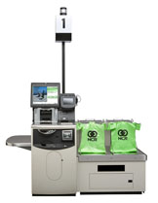

Steps for Process Capability Studies
Decide on the product or process characteristic to be assessed.
Required for all critical characteristics
If no critical characteristics exist, Jabil reserves the right to require demonstration of initial process capability on other characteristics
Step 1

Slide 79
Steps for Process Capability Studies
Validate the specification limits by
talking to:
Customers, suppliers, controlling agencies
Why is validation of the specification
limits important?
They may not represent what the customer truly desires/needs.
May contain “guard banding” as a result of past problems or measurement error.
They may be based on previous designs and no longer be valid.
Step 2

Slide 80
Steps for Process Capability Studies
Validate the measurement
system through the appropriate
MSA
Why is validation of the
Measurement System important?
If there is significant error in your measurement system, then decisions are influenced by the error not just the measurements themselves.
Step 3

Slide 81
Steps for Process Capability Studies
When collecting data, consider the
following:
Short term data
Free of special causes
Collected across a narrow inference space i.e. one shift, one machine, one operator, etc..
Long term data
Subjected to the effects of both random and special cause variation
Collected across a broad inference space i.e. multiple shifts, machines, operators, etc.
Step 4

Slide 82
Steps for Process Capability Studies
Assess data characteristics
Step 5
Examine the shape of your data.
Is it what you would expect? If not, investigate.
Bimodal Data
The shape of your data is important for determining which type of Capability Analysis applies.
Normal Data
Skewed Data

Slide 83
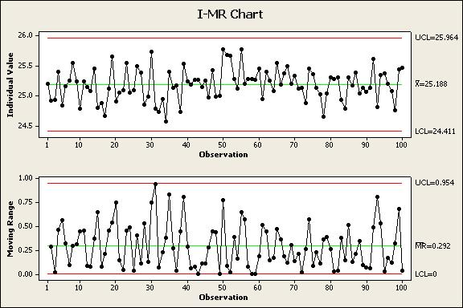
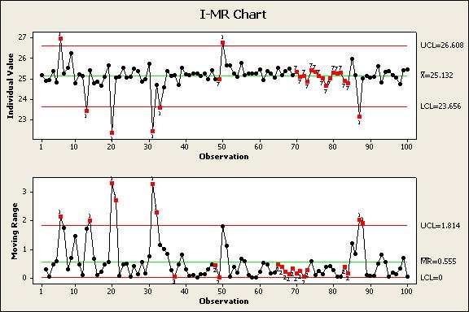
Steps for Process Capability Studies
Assess process stability in order to understand how your process behaves over time. Control charts are the recommended tool.
Step 6
Control Chart Examples
Process is stable and in control
Process is not stable and therefore not in control
Capability is only valid when the process being studied is stable!

Slide 84
Steps for Process Capability Studies
Calculate the appropriate statistical metrics in order to determine how the “Voice of the Process” compares to the “Voice of the Customer.”
Step 7
Capability Metrics: PPM, DPMO, Cp, Cpk, Pp,
& Ppk ; Sigma Levels (Z Scores)
Specification Limits
Specification Limits
Process is capable
Process is not capable

Slide 85
Process Capability Studies
The initial process study should be focused on variable, not attribute data
Assembly errors, test failures, and surface defects are examples of attribute data, which is important to understand, but is not covered in this initial study
To understand the performance of characteristics monitored by attribute data will require more data collected over time
Unless approved by an authorized Jabil representative, attribute data are not acceptable for PPAP submission
Focus on variable data

Slide 86
Capability Indices
Capability Index | Formula | What it shows
C_{p} |  | Relates short term (within subgroup) standard deviation to tolerance Sometimes called “Entitlement,” meaning it is the best the current process can do, if centered
C_{pk} |  | Relates short term mean & short term (within subgroup) standard deviation to tolerance Only tells you about the nearest spec limit; doesn’t tell anything about the other side
P_{P} |  | Relates long term (overall) standard deviation to tolerance
P_{pk} |  | Relates mean & long term (overall) standard deviation to tolerance Only tells you about the nearest spec limit; doesn’t tell anything about the other side
Cp/Cpk are used to estimate potential process capability
Pp/Ppk are used to measure actual process performance

Slide 87
Capability Indices
Cpk predicts capability
Based on short term within subgroup variation
Does not include the effect of process variability between subgroups
Cpk should be used when:
Developing new parts
Revising specifications on a part
Materials, processes, manufacturing location, or equipment have significantly changed
Material suppliers have changed (include certificate of analysis)

Slide 88
Capability Indices
Ppk indicates past performance
Based on long term total variation
Unlike Cpk, Ppk is not limited to variation within subgroups
However, Ppk cannot isolate within subgroup variation from between subgroup variation
When calculated from the same data set, Cpk and Ppk can be compared to analyze the sources of process variation
Ppk should be used when:
The supplier is new to Jabil, but has already been manufacturing a part
The supplier is existing, but has produced a number of nonconforming parts

Slide 89
Difference between Cp & Cpk
Cp – determines capability of producing to specification
Cpk – same as Cp, but also measures how centered the process is
It is important to look at both!
>
Cp
1.67
Cpk
>
Cpk
1.67
<
1.00
Capable, Centered
Capable, Not Centered
LSL
USL
LSL
USL
Cp
<
1.00
Cpk
<
1.00
Not Capable, Centered
Not Capable, Not Centered
LSL
USL
LSL
USL

Slide 90
APPEARANCE APPROVAL
REPORT

Slide 91
Appearance Approval Report
APPEARANCE APPROVAL REPORT (AAR)
Part # : |  |  | Part Name: |  |  |  | Project Name:
Drawing # : |  |  |  | Revision Level: |  |  | Rev Date
 |  |  |  |  |  |  |  |  | Submission Date:
COLOR EVALUATION (Spectrophotometer Readings):
Color Name: |  |  |  |  | Coating Type:
Color Standard No. |  |  |  |  | Coating Supplier :
Spectrometer Readings of samples versus color standard.
Measurement mode, CIE L*, a*, b*, 10deg. Observer, specular gloss included
 |  | Delta L* |  | Delta a* |  | Delta b* |  | Delta E |  | *Gloss Measurement
 |  |  |  |  |  |  |  |  |  | (Define -a and b- Locations)
 |  |  |  |  |  |  |  |  |  | a |  | b
MASTER Color chip readings
Sample 1 readings
Sample 2 readings
Sample 3 readings
Color and Gloss Readings were taken on : |  |  |  |  |  | Non textured side: |  |  |  | Textured side:
 | *(Specify with a check-mark)
Comments
TEXTURE EVALUATION:
DESCRIBE Texture requirements/standards:
DESCRIBE Method of inspection:
Results of Inspection:
What is It?
A report completed by the supplier containing appearance and color criteria
Objective or Purpose
To demonstrate that the part has met the appearance requirements on the design record
When to Use It
Prior to tooling for production
IMPORTANT!
Typically only applies for parts with color, texture,
or surface appearance requirements

Slide 92
Appearance Approval Report
APPEARANCE APPROVAL REPORT (AAR)
Part # : |  |  | Part Name: |  |  |  | Project Name:
Drawing # : |  |  |  | Revision Level: |  |  | Rev Date
 |  |  |  |  |  |  |  |  | Submission Date:
Administrative Section

Slide 93
Appearance Approval Report
COLOR EVALUATION (Spectrophotometer Readings):
Color Name: |  |  |  |  | Coating Type:
Color Standard No. |  |  |  |  | Coating Supplier :
Spectrometer Readings of samples versus color standard.
Measurement mode, CIE L*, a*, b*, 10deg. Observer, specular gloss included
 |  | Delta L* |  | Delta a* |  | Delta b* |  | Delta E |  | *Gloss Measurement
 |  |  |  |  |  |  |  |  |  | (Define -a and b- Locations)
 |  |  |  |  |  |  |  |  |  | a |  | b
MASTER Color chip readings
Sample 1 readings
Sample 2 readings
Sample 3 readings
Color and Gloss Readings were taken on : |  |  |  |  |  | Non textured side: |  |  |  | Textured side:
 | *(Specify with a check-mark)
Comments
Color measurement data
Gloss measurement data
Color and Gloss
measurement location

Slide 94
Appearance Approval Report
TEXTURE EVALUATION:
DESCRIBE Texture requirements/standards:
DESCRIBE Method of inspection:
Results of Inspection:
Texture requirements,
inspection method,
and inspection result.

Slide 95
Appearance Approval Report
APPEARANCE & COSMETIC EVALUATION:
Cosmetic requirements/ -standard procedure number- |  |  |  |  |  |  |  |  |  |  |  |  |  |  | Procedure Date/Rev:
Method of inspection:
 | SAMPLE 1 |  |  |  |  |  |  |  |  | SAMPLE 4
 | Class A | Class B |  | Class C | Class D |  |  |  |  | Class A |  | Class B |  | Class C |  | Class D
Pass |  |  |  |  |  |  |  |  | Pass
Fail |  |  |  |  |  |  |  |  | Fail
 | SAMPLE 2 |  |  |  |  |  |  |  |  | SAMPLE 5
 | Class A | Class B |  | Class C | Class D |  |  |  |  | Class A |  | Class B |  | Class C |  | Class D
Pass |  |  |  |  |  |  |  |  | Pass
Fail |  |  |  |  |  |  |  |  | Fail
 | SAMPLE 3 |  |  |  |  |  |  |  |  | SAMPLE 6
 | Class A | Class B |  | Class C | Class D |  |  |  |  | Class A |  | Class B |  | Class C |  | Class D
Pass |  |  |  |  |  |  |  |  | Pass
Fail |  |  |  |  |  |  |  |  | Fail
Surface cosmetic evaluation
as per the cosmetic
procedure requirements.
Sample size should be
No less than 2.

Slide 96
Appearance Approval Report
SIGNATURES AND APPROVALS
Comments |  |  |  |  |  |  |  |  | STATUS: | Approved | Reejected | Cond. App
Customer Approval
Printed Name: |  |  |  |  | Signature: |  |  |  |  |  | Date:
Jabil Site Quality / Engineering : |  |  |  |  | Signature: |  |  |  |  |  | Date:
Note: | If golden or boundary samples are approved and signed off by Customer, Please submit a couple of the most representative parts to the supplier for future reference.
Approval and signature by
Customer or Jabil.
One copy of sample should be
return to supplier for reference.
Jabil site decide whether one
more copy of sample
needed for retention in Jabil.

Slide 97
SAMPLE PRODUCTION PARTS

Slide 98
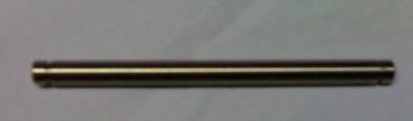
Sample Production Parts
What is It?
Actual samples that reflect the parts documented in the PPAP.
Objective or Purpose
Confirm cosmetic or functional part approval.
When to Use It
Sample parts should be delivered WITH the PPAP submission

Slide 99
Sample Production Parts
The sample parts provided should be the same parts measured for the dimensional results
Default quantity for all submissions is 3 parts unless otherwise requested

Slide 100
Sample Production Parts
Sample production parts MUST be properly identified
Include the following information on the part label:
Date parts were packed
Jabil part number
Quantity
Serial number
Supplier part number (optional)
Part description
Country of origin
Indication of RoHS compliance
Approval markings (UL, CE, etc.) where applicable

Slide 101
PPAP Summary
The Production Part Approval Process is an extensive approval process for new or changed designs or processes
It is very formalized, so it inevitably causes some administrative work
Later changes to the product or process can be expensive and time-consuming!

Slide 102
Thank You

